Slide 1
React JS
(jsx)
Lecture- 4

Slide 2
Today’s Agenda
What is JSX ?
Characteristics Of JSX ?
Coding JSX
Expressions In JSX
Inserting A Large Block Of HTML

Slide 3
What Is JSX ?
To understand this , take a look at the code given below :
What do you think it is ?
Is it JavaScript or is it HTML ?
The answer is NONE.
It is called JSX.
let myElement = <h1>Hello User!</h1>;

Slide 4
What Is JSX ?
JSX stands for JavaScript Syntax Extension.
It is used in React to easily write HTML and JavaScript together.

Slide 5
Why JSX ?
Using React.createElement() was the old way of writing code in React .
However it's tedious to write the React.createElement() every time, even for adding a simple div.
So React introduced the JSX way of writing code which makes code easy to write and understand.

Slide 6
Advantages Of JSX
JSX can easily convert HTML tags to react elements.
It is faster than regular JavaScript.
JSX allows us to put HTML elements in DOM without using appendChild() or createElement() method.

Slide 7
Coding JSX
Let us understand the benefit of JSX with two examples, the first uses JSX and the second does not:
Example 1: With JSX
Example 2: Without JSX
let myelement = <h1>Hello User!</h1>;
ReactDOM.render(myelement, document.getElementById('root'));
let myelement = React.createElement(‘h1’, null , “Hello User”);
ReactDOM.render(myelement,document.getElementById('root'));

Slide 8
How Will Browser Understand JSX ?
The browser does not understand this JSX because it's not valid JavaScript code.
This is because we're assigning an HTML tag to a variable that is not a string but just HTML code.

Slide 9
How Will Browser Understand JSX ?
So to convert it to browser understandable JavaScript code, we need to use a special tool.
This tool is called Babel which is a JavaScript transpiler.

Slide 10
What Is Babel ?
Babel is a JavaScript transpiler/compiler.
It has the ability to compile JSX into regular JavaScript code.
It can also convert ECMAScript 2015+ code into a backwards compatible version of JavaScript in current and older browsers or environments.

Slide 11
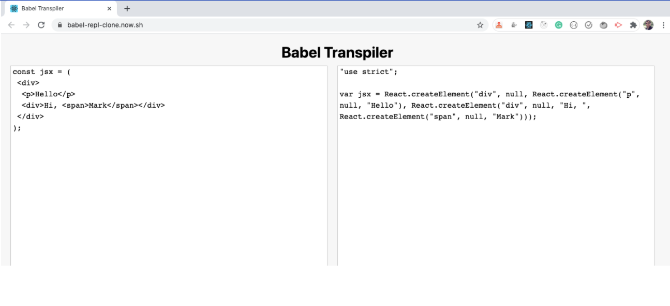
What Is Babel ?

Slide 12
How To Add Babel To Our Code ?
To add Babel we need to reference another library.
Just below the two script tags, add the following line:
<script src="https://unpkg.com/@babel/standalone/babel.min.js"></script>

Slide 13
How To Add Babel To Our Code ?
Here we’re adding a reference to the Babel JavaScript transpiler (http://babeljs.io/).
Babel does many cool things, but the one we care about is its capability to turn JSX into JavaScript.

Slide 14
A Very Important Point
Since we are using babel and JSX , so the we will have to set the type attribute also with our <script> tag .
The value of type attribute should be “text/babel”.
<script type=“text/babel”>
// JSX code
</script>

Slide 15
The Final Code
<!DOCTYPE html>
<html lang="en">
<head>
<title>Using React With CDN</title>
<script crossorigin src="https://unpkg.com/react@18/umd/react.development.js">
</script>
<script crossorigin
src="https://unpkg.com/react-dom@18/umd/react-dom.development.js">
</script>
<script src="https://unpkg.com/@babel/standalone/babel.min.js"></script>
</head>
<body>
<div id="root"></div>
<script type=“text/babel”>
let myElement = <h1>React Rocks!!!</h1>;
let mydiv = document.querySelector("#root");
ReactDOM.render(myElement, mydiv);
</script>
</body>
</html>

Slide 16
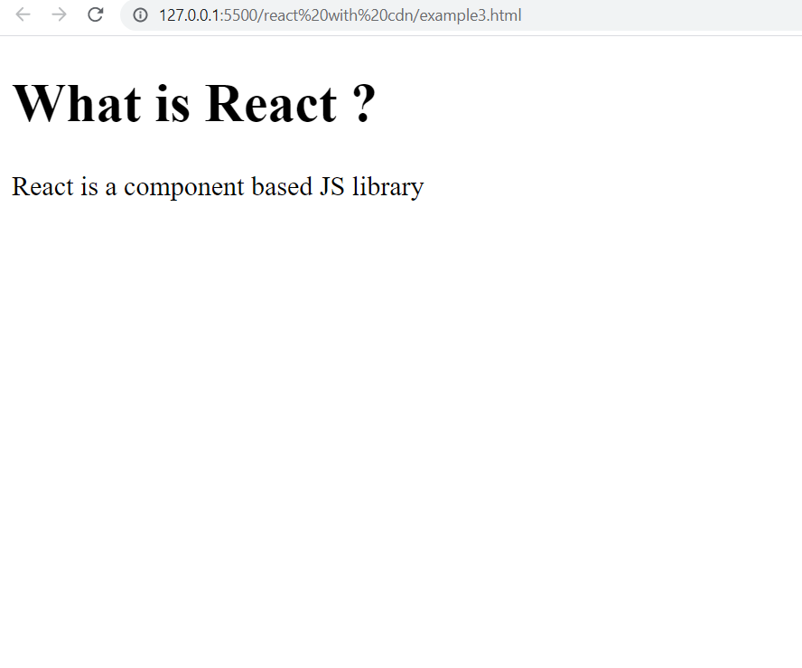
Exercise
Design the following App using JSX
Make sure to use function for returning your React element

Slide 17
Solution
<script type=“text/babel”>
function MyApp() {
let myElement = (
<div>
<h1>What is React ?</h1>
<p>React is a component based JS library</p>
</div>
);
return myElement;
}
let mydiv=document.querySelector("#root");
ReactDOM.render(React.createElement(MyApp),mydiv);
</script>

Slide 18
A Very Important Point
Since we are using Babel, so React allows us to simplify the call to render() method also.
This can be done by passing the name of our function as a tag as the first argument to render()
let mydiv = document.querySelector("#root");
ReactDOM.render(<MyApp />, mydiv);

Slide 19
Modified Solution
<script type=“text/babel”>
function MyApp() {
let myElement = (
<div>
<h1>What is React ?</h1>
<p>React is a component based JS library</p>
</div>
);
return myElement;
}
let mydiv=document.querySelector("#root");
ReactDOM.render(<MyApp/>,mydiv);
</script>

Slide 20
Expressions In JSX
With JSX we can write JavaScript expressions inside curly braces { }.
The expression can be a React variable, or property, or any other valid JavaScript expression. JSX will execute the expression and return the result:
Example: Execute the expression 5+5
let myelement = <h1>React is {5 + 5} times better with JSX</h1>;

Slide 21
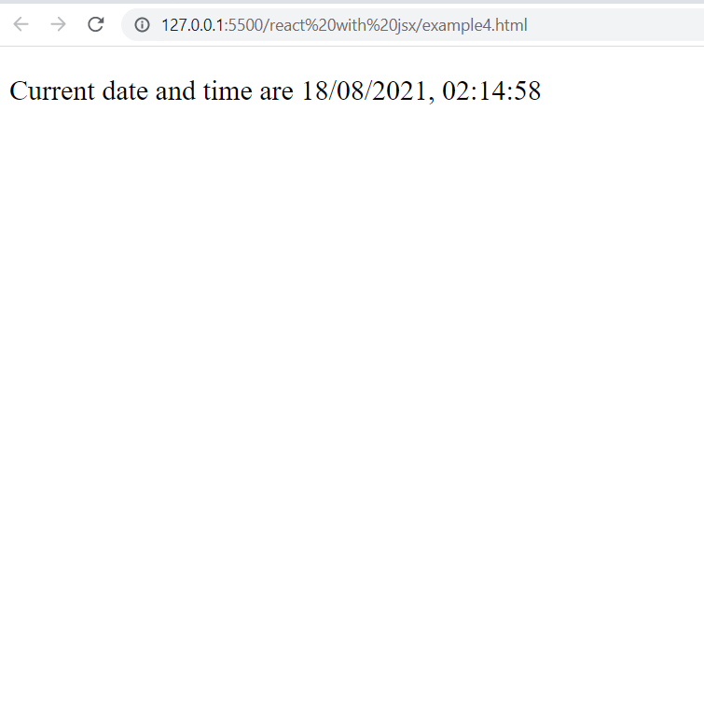
Exercise
Design the following App using JSX to create a function that returns a React element representing the current date and time in local time zone

Slide 22
Solution
<script type=“text/babel”>
function MyApp() {
let now = new Date().toLocaleString();
return <p>Current date and time are {now} </p>;
}
let mydiv=document.querySelector("#root");
ReactDOM.render(React.createElement(MyApp),mydiv);
</script>

Slide 23
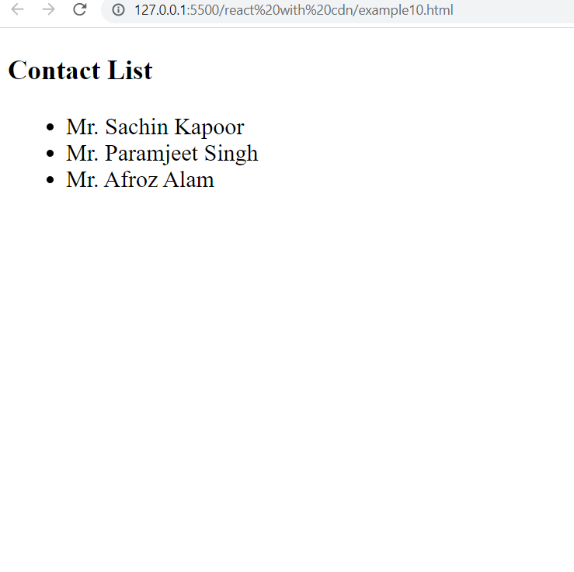
Exercise
Design the following App using JSX
Make sure to use function for returning your React element

Slide 24
Solution
<script type=“text/babel”>
function MyApp() {
let myHeading = <h3>Contact List</h3>;
let myList = (
<ul>
<li>Mr Sachin Kapoor</li>
<li>Mr Paramjeet Singh</li>
<li>Mr Afroz Alam</li>
</ul>
);
return (
<div>
{myHeading}
{myList}
</div>
);
}
let mydiv=document.querySelector("#root");
ReactDOM.render(React.createElement(MyApp),mydiv);
</script>

Slide 25
Inserting A Large Block Of HTML
To write HTML on multiple lines, put the HTML inside parentheses ():
Example: Create a list with 3 items
const myelement = (
<ul>
<li>Apples</li>
<li>Bananas</li>
<li>Cherries</li>
</ul>
);

Slide 26
JSX Rules
JSX is stricter than HTML and thus we must follow certain rules otherwise the code will give errors.
The three most common rules of JSX are:
There must be a root/parent element for the entire JSX being returned
Every opening tag must have closing tag
Attribute names follow camelCase notation

Slide 27
One Root Element
The HTML code must be wrapped in ONE root element.
So if you like to write two headers, you must put them inside a parent element, like a div element.
Example: Wrap two headers inside one DIV element:
Note: JSX will throw an error if the HTML is not correct, or if the HTML misses a parent element.
const myelement = (
<div>
<h1>I am a Header.</h1>
<h1>I am a Header too.</h1>
</div>
);

Slide 28
Element Must Be Closed
JSX follows XML rules, and therefore HTML elements must be properly closed.
Example: Close empty elements with />:
Note: JSX will throw an error if the HTML is not properly closed.
const myelement = <input type="text" />;

Slide 29
Attribute Names
JSX allows us to use attributes with the HTML elements just like we do with normal HTML.
But instead of the normal naming convention of HTML, JSX uses camelcase convention for attributes.
So onclick of HTML becomes onClick in JSX.
Similarly onmousedown becomes onMouseDown .

Slide 30
An Important Point
The class attribute is a much used attribute in HTML, but since JSX is rendered as JavaScript, and the class keyword is a reserved word in JavaScript, you are not allowed to use it in JSX.
Use attribute className instead class.
When JSX is rendered, it translates className attributes into class attributes.

Slide 31
Attribute class = className
Example: Use attribute className instead of class in JSX:
let myelement = <h1 className=“myclass”> Hello World </h1>;

Slide 32
Summary
React JSX rules must be follow while using React.
Return Single Statement: In JavaScript we use to return JSX elements to DOM through components. We return HTML elements or tags to render it later. So one of the rule is to return single element.
Use camelCase for HTML Attribute: In JavaScript we used to write inline attributes or event Listeners e.g. “onclick()”. But in case of React we can’t write attributes like this. “onclick” attribute of JavaScript must be capitalized e.g. camelCase.

Slide 33
Summary
className Instead of Class: In HTML we use class attribute for specific element. As we are using React, a JavaScript library so we can’t use class keyword because in ES6 it is a reserve keyword to define a class.
Close Every Element: In React JSX every tag must be close even those which have no closing tags

Slide 34
Summary
Formatting: While returning JSX we should have parenthesis so the HTML code must be wrapped inside.
Expressions: With JSX we can write expressions inside curly braces { }.

Slide 35
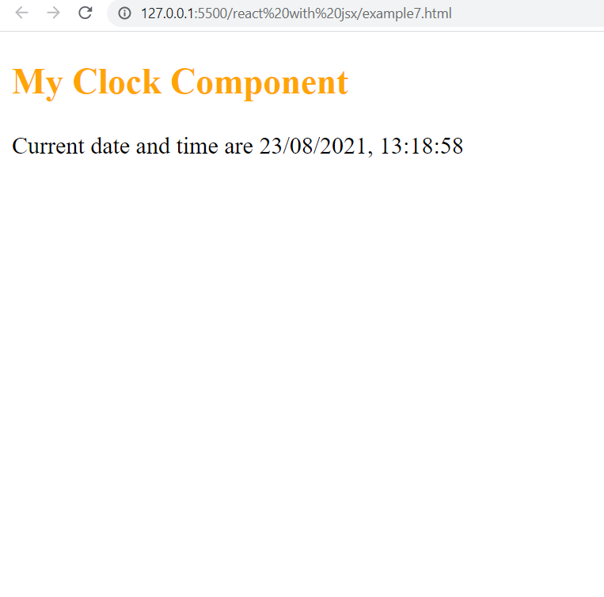
Exercise
Design the following App using JSX
Make sure to use function for returning your React element

